Slide 1
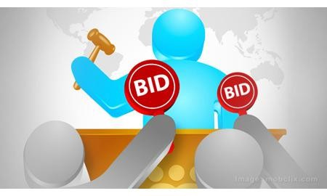



BIDDING SYSTEM

Slide 2


PROJECT MEMBERS
Id number
Name
190031839
D.RAHUL SRINIVAS
190031142
N.VAMSINATH REDDY
190031888
J.LAKSHMI NAVYA

Slide 3

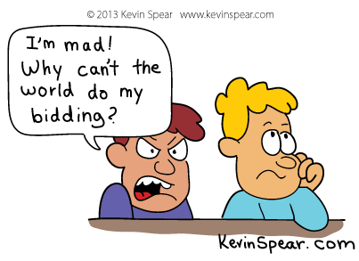
INTRODUCTION
BIDDING:
What do mean by BIDDING?
Bidding is an offer to set a price tag by an individual or business for a product or service or a demand that something be
done. Bidding is used to determine the cost or value of something.
Bidding can be performed by a person under influence of a product or service based on the context of the situation. In the context of auctions, stock exchange, or real estate the price offer a business or individual is willing to pay is called a bid. In the context of corporate or government procurement initiatives, the price offer a business or individual is willing to sell is also called a bid. The term "bidding" is also used when placing a bet in card games. Bidding is used by various economic niches for determining the demand and hence the value of the article or property, in today's world of advanced technology, the Internet is a favored platform for providing bidding facilities; it is a natural way of determining the price of a commodity in a free market economy.

Slide 4
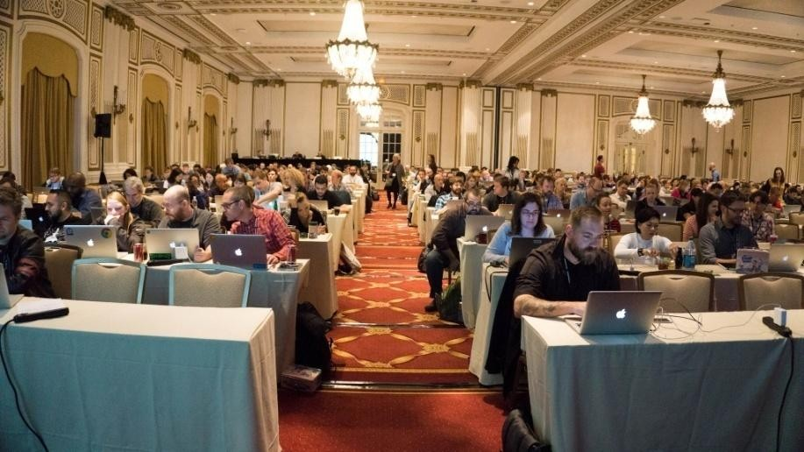

Online bidding:
online Bidding performs in two ways :- unique bidding and dynamic bidding.
Unique bidding: In this case bidders place bids that are global unique bids which means that for the bid to be eligible, no other person can place the bid in this amount and the biddings are usually secret. There are two variants of this type of bidding : highest unique bidding and lowest unique bidding.
Dynamic bidding: This is a type of bidding where one user can set his bid for the product. Whether the user is present or not for the bidding, the bidding will automatically increase up to his defined amount. After reaching his bid value, the bidding stops from his side.

Slide 5

Auction project:
An online auction project that holds online auctions of various products on a website and serves sellers and bidders accordingly.
The system is designed to allow users to set up their products for auctions and bidders to register and bid for various products available for bidding.
Online Auction or the E auction system project consists of the following parts:
Bidder Login: Here the buyer or the product bidder can see a list of products up for bidding and place his/her bid on the product.
Seller Login: This is the seller module where the seller posts a product up for auctions.
Admin Login: This module is for the administrator who may delete fake or unwanted ads.
Report generation: Admin gets a report whenever wanted stating various products up for bidding and various users registered on the website.
SMS notification: Auction winners and losers get an sms notification whether they won or lost the bid.

Slide 6
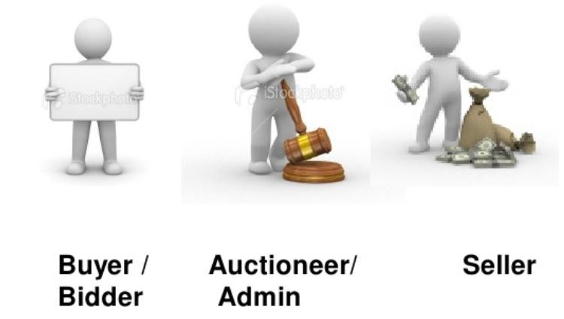
USER INVOLVED :
Bidder or buyer:
the one who is keen on buying products for a relatively competitive price by placing multiple bids
Admin or auctioneer :
one who is responsible to judge the auction one who takes the decision of selection bid
Seller:
responsible to provide or arrange an opportunity for auctions

Slide 7
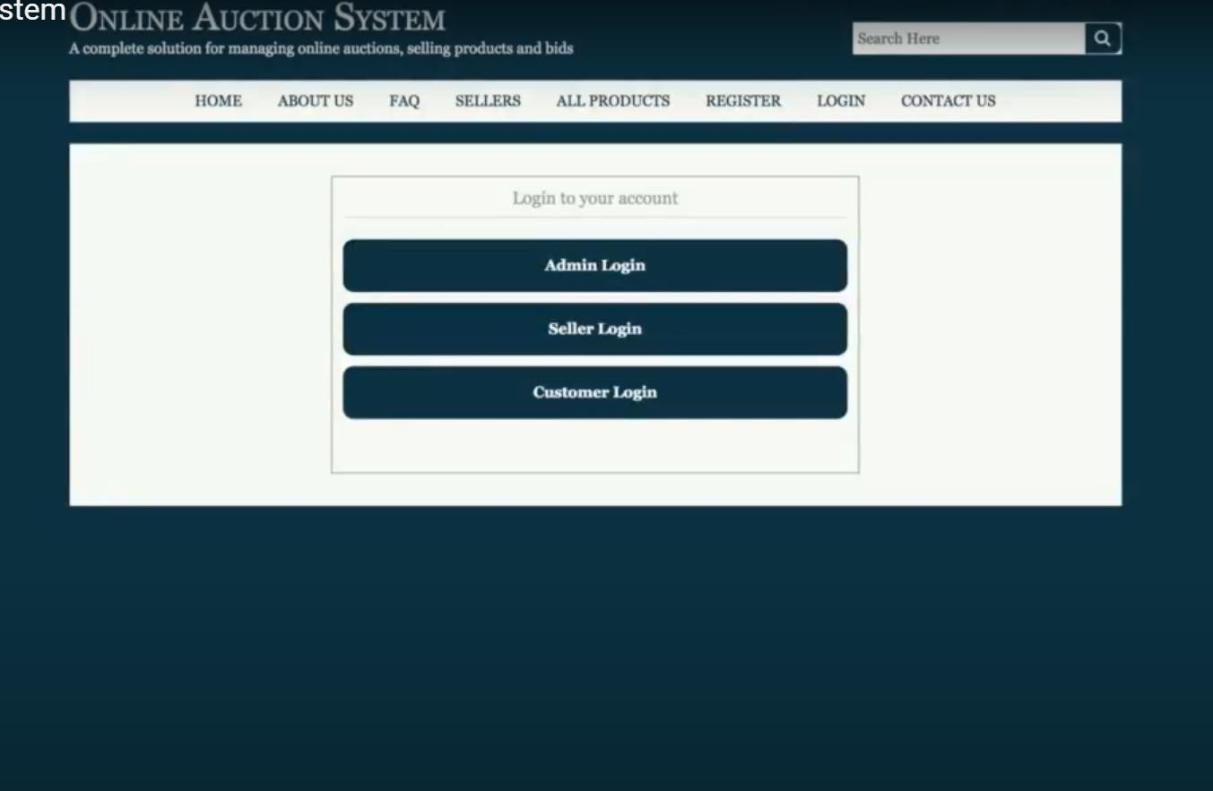
ONLINE AUCTION APP SCREENSHOTS :
We have to login into our current account(admin , seller , customer)through which u want to login.
To create a web site we use HTML or virtual studio code
for MEAN STACK WEB DEVELOPMENT(MSWD),because it is an open source software package .

Slide 8
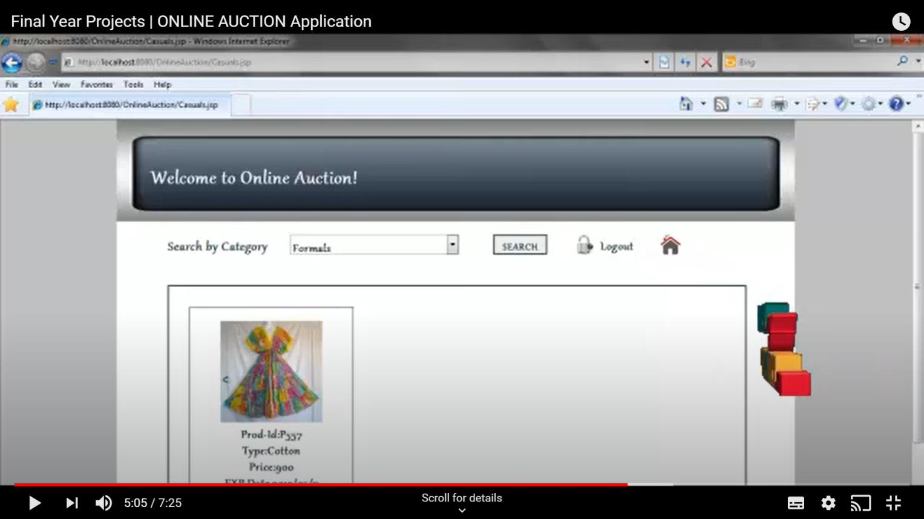
For searching products we use Artificial Intelligence which helps in searching the product we need ,here we implement some code to access the search operation we use node.js

Slide 9
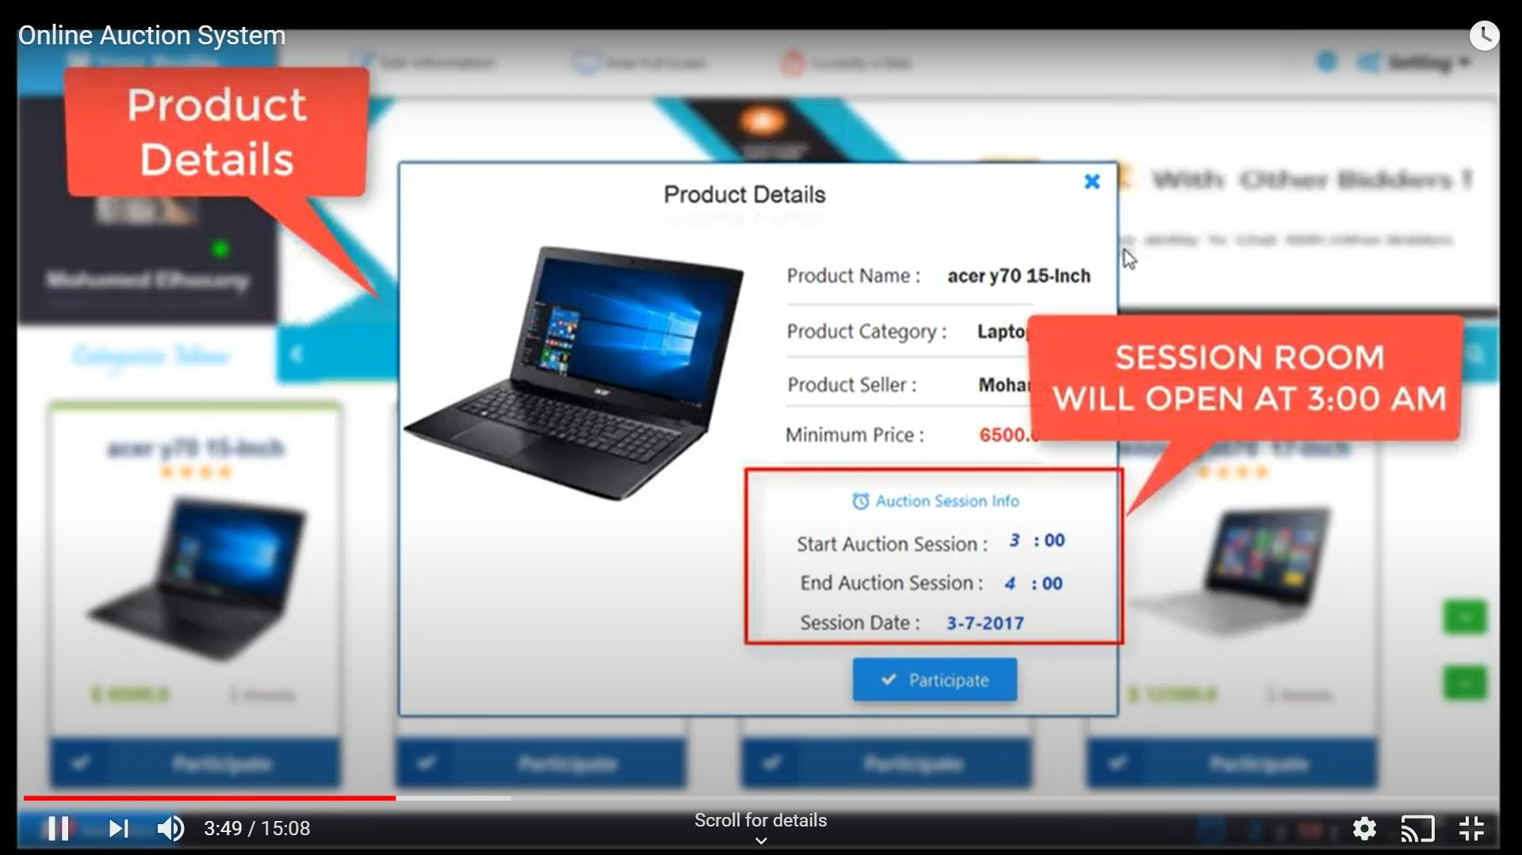
To store data of the seller and details of the product such as(value prize and date & duration)and also buyer bidding price and details of them to store those data we use the DATA BASE MANAGEMENT SYSTEM(DBMS) like MYSQL.

Slide 10
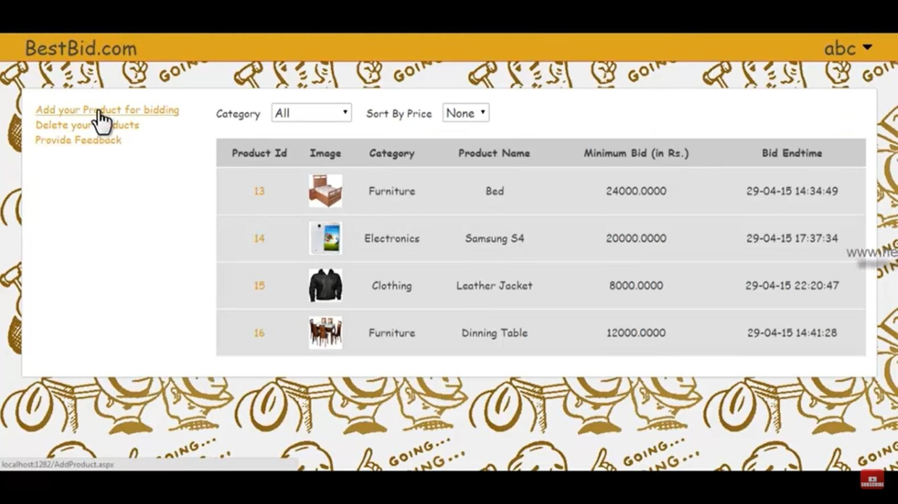
Total bidding price is calculated using mathematical programming it calculate the valued price and bidding price

Slide 11




Advantages :
No noisy crowds like conventional system where users have to sit and bid.
Excludes general frustration that usually happens while bidding in conventional system.
No schedule constraint that means bidder can bid any time and from anywhere.
The bidding process can be conducted on a global scale

Slide 12


Disadvantages :
The user cannot view the item In person
Thank you

Slide 13
SOFTWARE
REQUIREMENT SPECIFICATION

Slide 14
Let’s take a look at the requirements at user as well as the portal’s end.
  FUNCTIONAL & NON FUNCTIONAL REQUIREMENTS
The functional capabilities which make up an e-purchasing system suitable for public procurement specified as the following:
Many-to-many functionality (Many buyers to many sellers), decentralized buyers and sellers, search for suppliers by name, category, locality code, and contract, create purchase requisitions ,generate purchase orders while including optional approver workflow, receive goods into the system, allow for the customization of "buy policies", buyer data management, supplier data management.

Slide 15
Following are the non-functional requirements :
    Performance
The system must be interactive and the delays involved must be less. So in every action- response of the system, there are no immediate delays. In case of opening windows forms, of popping error messages and saving the settings or sessions there is delay much below 2 seconds

Slide 16
    Safety
Information transmission should be securely transmitted to server without any changes in information
Reliability
As the system provide the right tools for discussion, problem solving it must be made sure that the system is reliable in its operations and for securing the sensitive details.
Availability
If the internet service gets disrupted while sending information to the server, the information can be send again for verification.

Slide 17
Security
The main security concern is for users account hence proper login mechanism should be used to avoid hacking. The tablet id registration is way to spam check for increasing the security. Hence, security is provided from unwanted use of recognition software.
Usability
As the system is easy to handle and navigates in the most expected way with no delays. In that case the system program reacts accordingly and transverses quickly between its states.

Slide 18
  USER REQUIREMENTS:
The system primarily has 3 types of users:

Slide 19
    Seller module
A seller’s primary concern on such a portal would be security against fraudulent buyers and random bids. The seller needs to know who got the product and needs to actaccordingly. The seller must be able to check his product for bidding and should be able to add one easily. He should also be able to see the reviews about the product and
communicate with the customers or bidders regarding any issue that arises.

Slide 20
    Buyer module
The bidder should first see which product is been posted on the app which is to be auctioned along with all the needed information about it. If the bidder is interested to buy that product, then he can register for the auctioning and bid the amount. At last, at the end of the
auctioning the bidder should get to know the result. The buyer or the bidder should be able to give a feedback to the seller or admin.

Slide 21
Admin module
The admin must be the one who controls the entire bidding process by deciding the expiry time of each bid. He must be able to add, remove or manage a category. Admin must be able to add or delete comments and take feedback from people regarding the processes going on in the portal.

Slide 22
  SYSTEM REQUIREMENTS
Dedicated application server with minimum specification, are as:
    Intel Core 2 Quad
    Memory 2*2GB DDR3
    Hard Disk 1 x 360 GB HDD SATA
    Ethernet Card 10/100/1000 Mbps e. Microsoft Windows 2003 Small Business Server.

Slide 23


